Slide 1
Sentimental Analysis And Prediction Tool
Kushal Master (17dcs028)
Prince Makwana(17dcs027)
Pritul Dave(17dcs008)
Guided by:-Mohammed bohara

Slide 2
Background
In large organization, different groups, teams and customers communicates daily through multiple channels. The perception of overall situation from this communication is difficult to understand.
Social Media is key player in communications between large organizations and customers. Customers share their idea of various products and give their feedback on promoting some products which are valuable.
This type communications helps large organizations to understand the sentiments of people and can compare their market with other organizations.
The Sentiment Analysis and Prediction tool is based on the concept of real time prediction of customer reviews and predict the performance in market. This tool can also be used as prediction for internal working of different departments of large organizations.

Slide 3
Existing system
Existing approaches to sentiment analysis can be grouped into three main categories: knowledge-based techniques, statistical methods, and hybrid approaches. Knowledge-based techniques classify text by affect categories based on the presence of unambiguous affect words such as happy, sad, afraid, and bored.
Some knowledge bases not only list obvious affect words, but also assign arbitrary words a probable "affinity" to particular emotions.

Slide 4
Proposed System
Statistical methods leverage elements from machine learning where we do
Sentiment Classification:-
Positive sentiments
Negative sentiments
At initial stage, Natural language processing (NLP) will be used but if we want to classify a sentence as positive, negative or neutral then in such case, NLP may not give accurate results.
As the system matures with large amount of data, a neural network model can be trained to predict the sentiments.
The input would be the csv file, based on the input received, the processing of the input is done and classified sentiments are displayed.

Slide 5
Proposed System
Sentiment Information Extraction
Use of mixed sentiment dictionary, a degree adverb dictionary from the Internet, and a negative word dictionary developed by the developers to obtain sentiment elements from opinion sentences. Mixed sentiment dictionary - sentiment words along with their sentiment score.
Degree Adverb Dictionary from the Internet - adverb words along
with their degree score.
Negative word dictionary - database can have many negative words.
Use above 3 dictionaries - compare words in opinion sentences to
conﬁrm the type of each word and determine the word score.

Slide 6
Requirement Gathering Techniques Used
Brainstorming
Document Analysis
Focus Group
Interview
Observation
Prototyping

Slide 7
Hardware and Software Requirements
In terms of hardware, a Smart Phone or Desktop Computer (or a laptop), with a compatible class browser is needed at the user end
For software there will be fundamentally one platform on which our Web Portal is working is required. Hence any Desktop, Laptop or Smart Phone with a modern browser like the latest versions of Google Chrome, Apple Safari or Microsoft Edge would work
Minimum RAM of 2GB and Minimum hard disk space of 5MB .

Slide 8
Project Definition and Planning
Sentiment Analysis and Prediction tool is based on the concept of real time prediction of customer reviews and predict the performance in market. This tool can also be used as prediction for internal working of different departments of large organizations.

Slide 9
Project Planning

Slide 10
Implementation Details.
For implementing we have used
Python 3.x
Flask
Natural Language Processing
Twitter API
HTML/CSS/Bootstrap
Jquery and JS
Dash Plotly

Slide 11
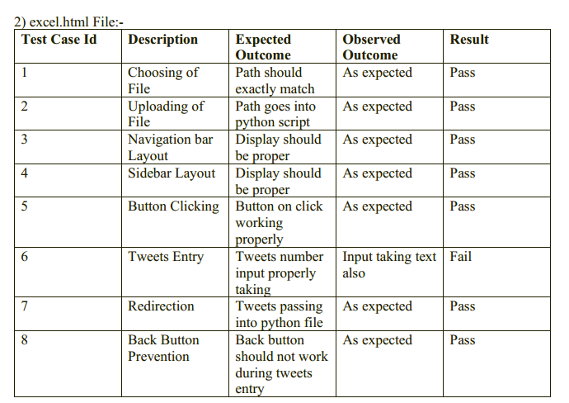
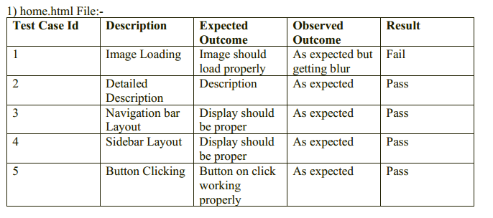
Testing Scenarios.

Slide 12
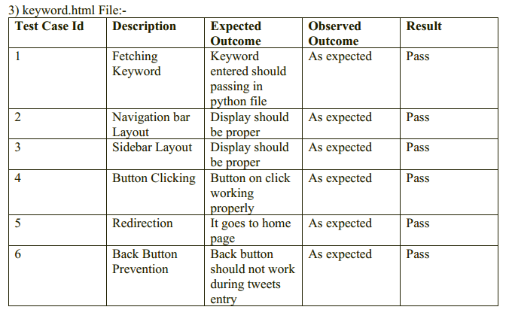
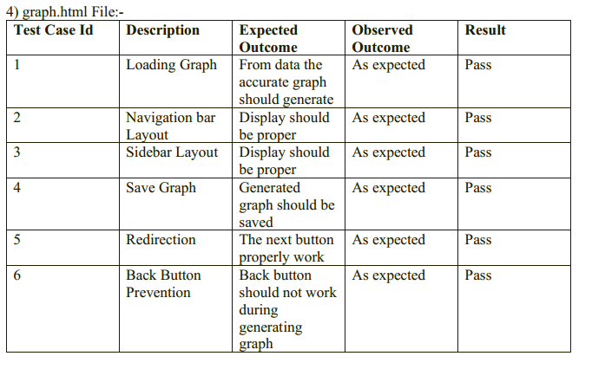
Testing scenario

Slide 13
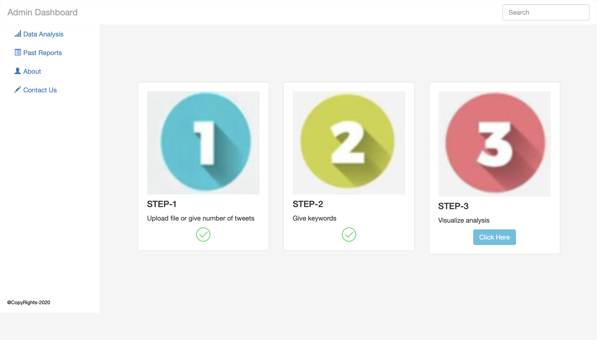
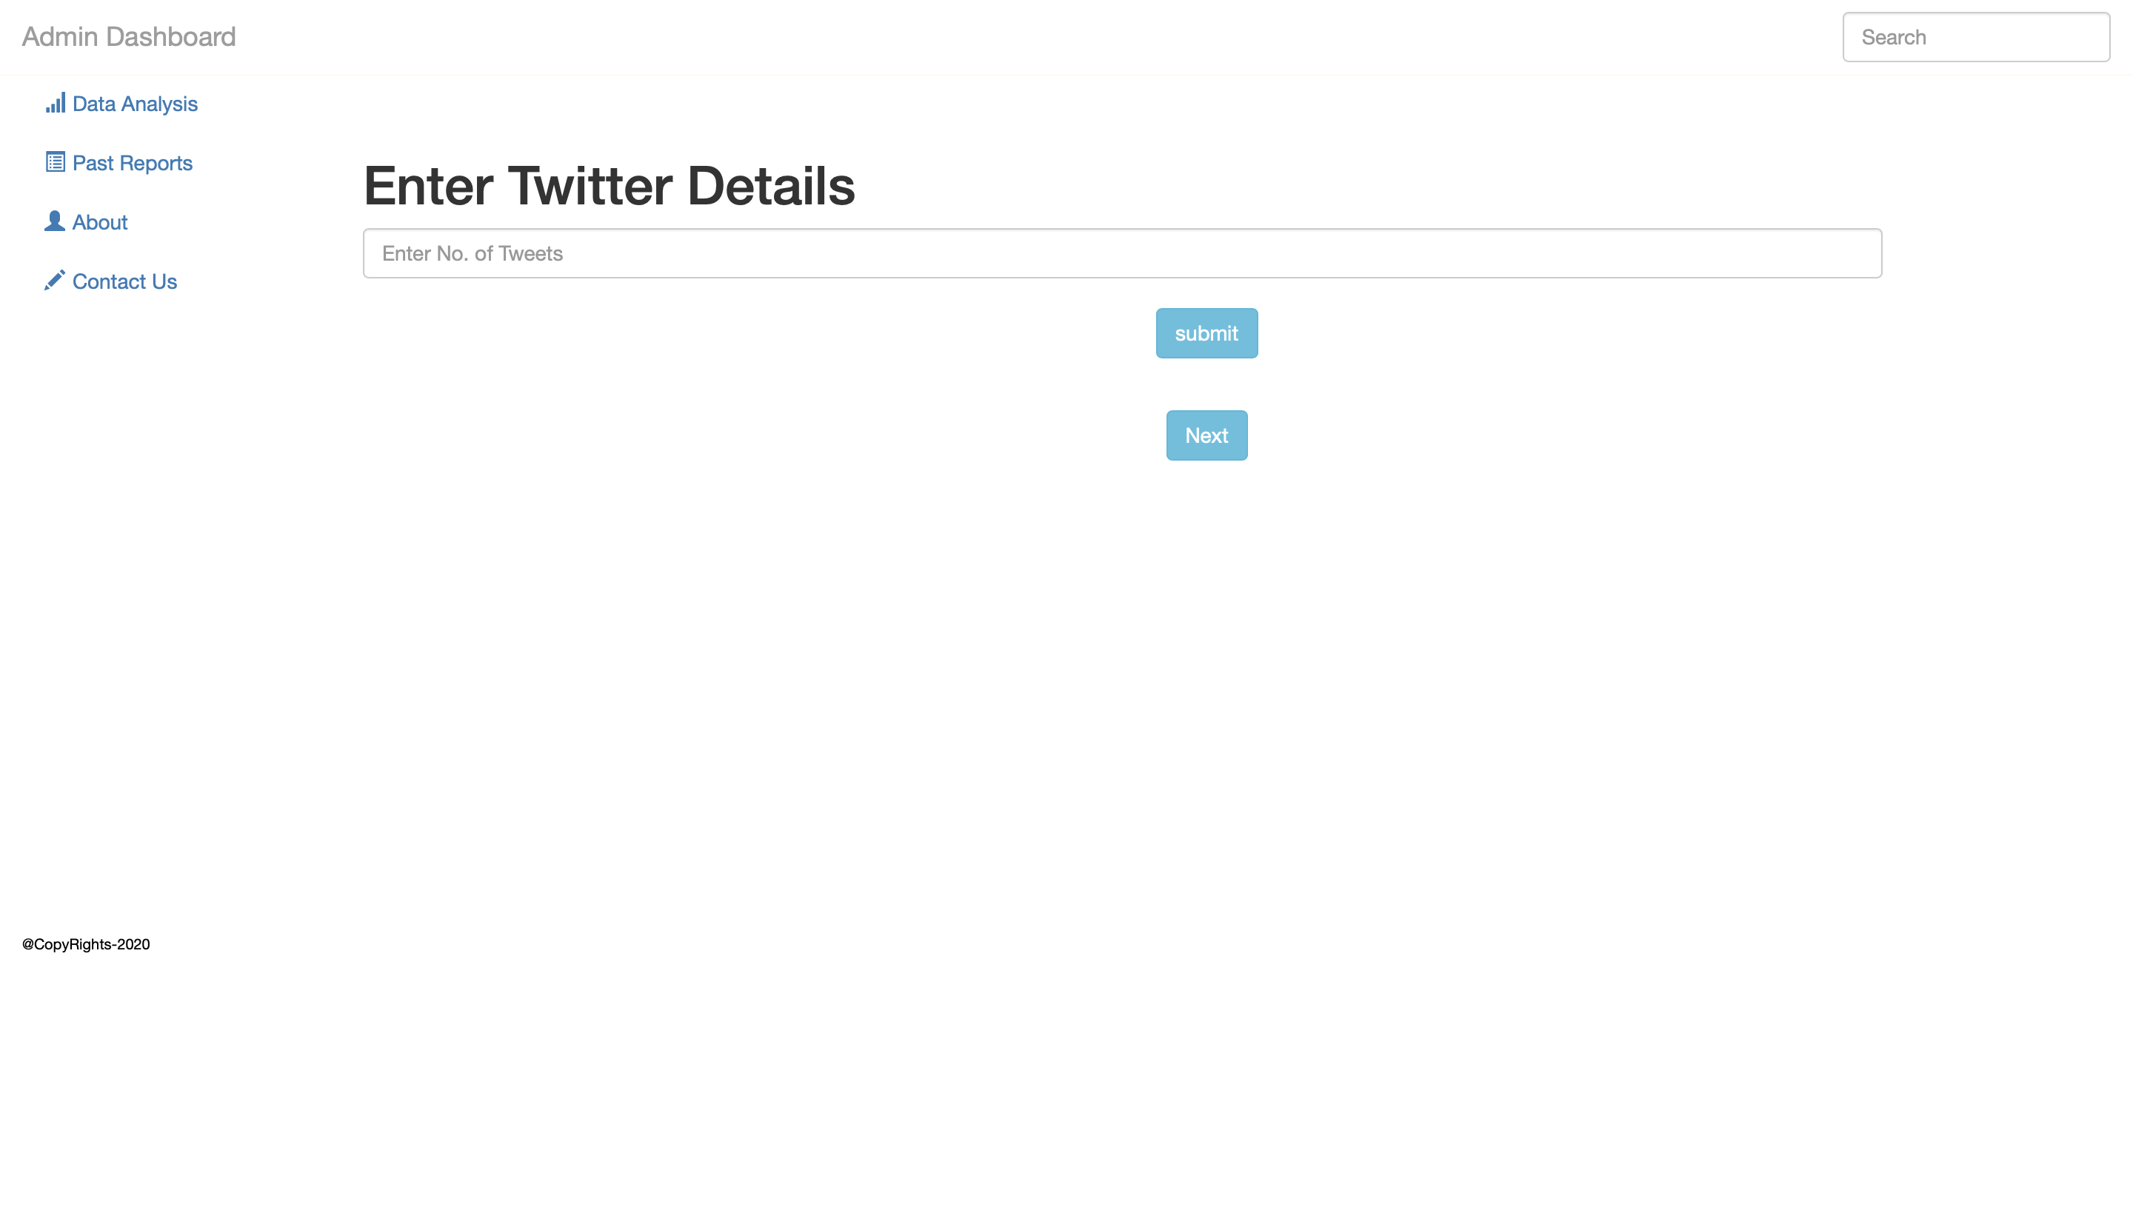
Demonstration

Slide 14
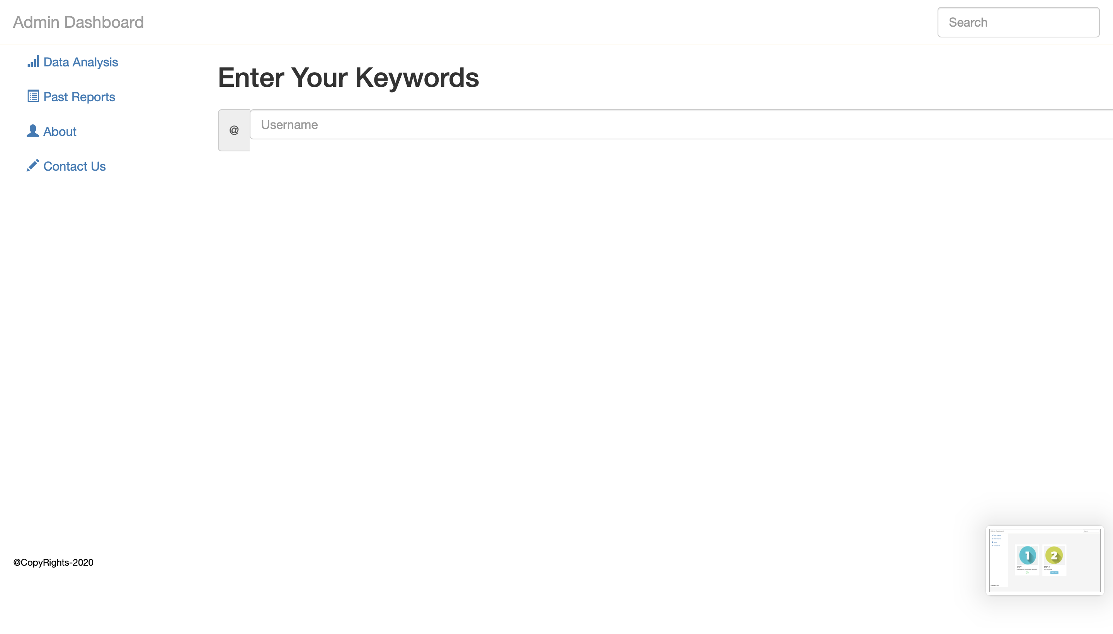
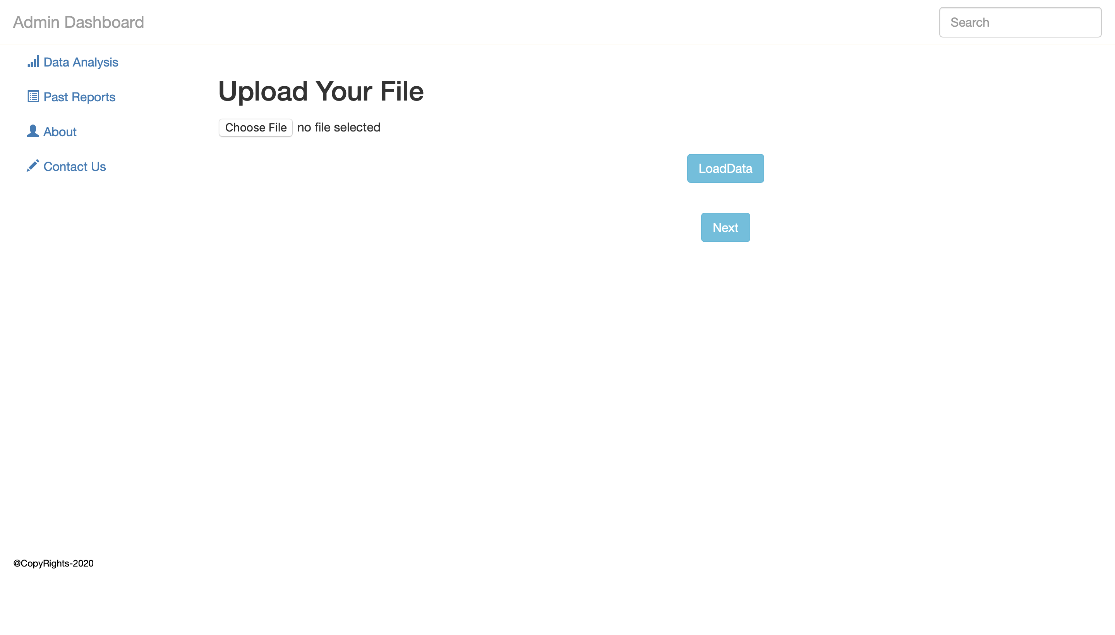
Demonstration

Slide 15
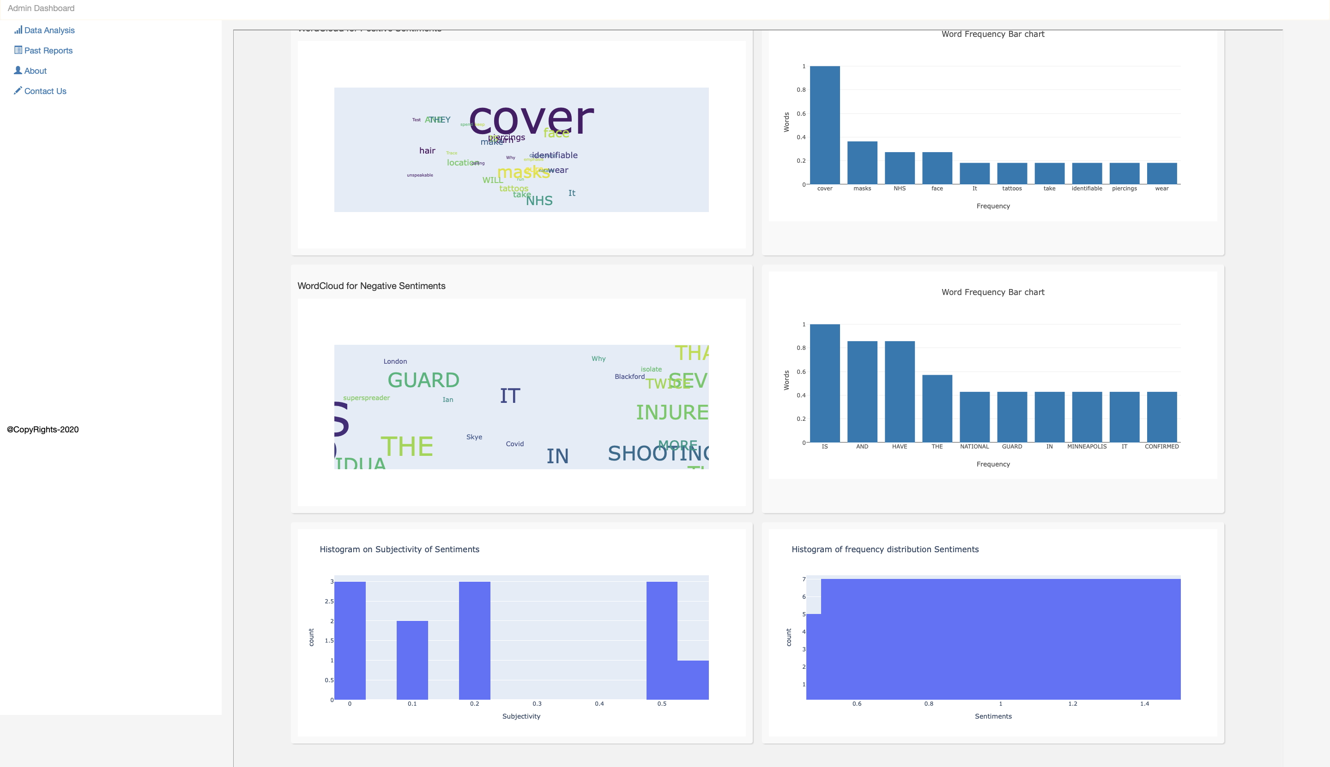
Demonstration

Slide 16
Limitations and Future Scope
Limitation
API keys
real time tweets not be given
Account for twitter required to purchase
Future scope:-
Taking more features for analysis from twitter

Slide 17
Conclusion
In multi social era the perception of different people is different and give different reviews so we analyze the sentiment of the people and apply the business intelligence logics on this positive, negative and neutral sentiments to transform this raw data into meaningful and useful information which enable more effective strategic, tactical, and operational insights and decision-making

Slide 18
References.
https://jsonapi.org/
https://flask.palletsprojects.com/en/1.1.x/
https://developer.twitter.com/en
https://dash.plotly.com/
https://arxiv.org/pdf/1612.01556.pdf

